Slide 1
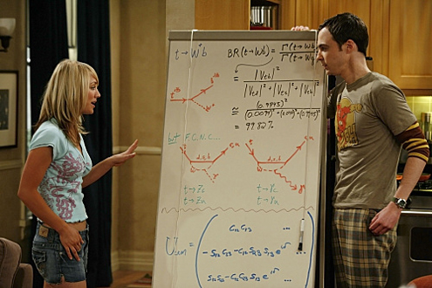
Research Introduction
What do we mean by doing research?

Slide 2


Research Beginnings:
What we will be covering:
1. Introduction
1. What is research?
2. Why do research?
3. Where does research fit in.
2. Where to start
1. The research question.

Slide 3

Research Beginnings;
What we will be covering: cont
3. Answering the Question
1. First Steps – Related literature
2. What do we mean by related literature?
3. Once you have the literature what do you do with it?

Slide 4
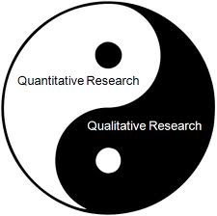
Research Beginnings;
What we will be covering: cont
4. Designing the research
1. What Methodology?
2. Which is best?
3. Quantitative
4. Qualitative
5. Design Science
6. Mixed Method

Slide 5

Research Beginnings;
What we will be covering: cont
5. Getting the data
1. The Population
2. Sampling

Slide 6

Research Beginnings;
What we will be covering: cont
6. Once you have the data is it real
1. Reliability
2. Validity
3. What else can go wrong?
4. What to do with the results

Slide 7
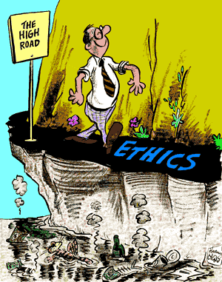
Research Beginnings;
What we will be covering: cont
7. Is it ethical
1. Subjects
2. Results
3. Design

Slide 8
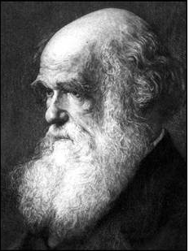
Research Beginnings;
What we will be covering: cont
7. Theory
1. Theory what is it?
2. Where does it fit in the scheme of things?

Slide 9
Introduction
Research is a process of steps used to collect and analyse information to increase our understanding of a topic or issue.
Consists of three steps.
1. Pose a question.
2. Collect data to answer the question.
3. Present and answer to the question.
Creswell, J.W. (2009) Educational Research.

Slide 10
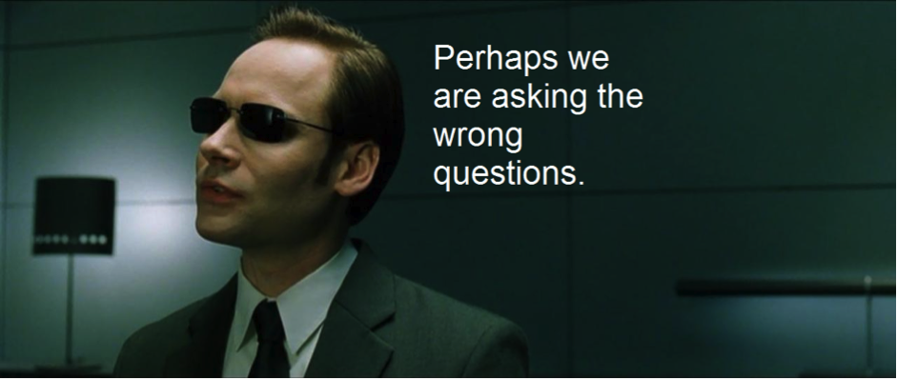
The Process
1. Pose a question.

Slide 11

The Process
2. Collect data to answer the question.

Slide 12

The Process
3. Present and answer to the question.

Slide 13

Why do we carry out Research?
1. Research adds to our body of knowledge.
a) provide new insights in to a phenomena.
b) confirm results or disconfirm results from prior studies.

Slide 14

Why do we carry out Research?
2. Can improve practice.
a) help improve current practice.
b) can come up with new ideas and way to do things.

Slide 15

Why do we carry out Research?
3. Research informs policy debates.

Slide 16
Introduction to Research
When researchers conduct a study they proceed through a distinct set of steps. This has been identified as the “scientific method” of inquiry.
1. Identifying a research problem
2. Reviewing the Literature.
3. Specifying the purpose of the research.
4. Collecting the data.
5. Analysing and interpreting the data.
6. Reporting and evaluating the research.

Slide 17
Introduction to Research
Conducting research is more than engaging in major steps in the process of research. It also includes designing and writing the research in one of the two major tracks: quantitative and qualitative research. The other thing to think about depending on the research question you can blend the two methods into a mixed method design.

Slide 18
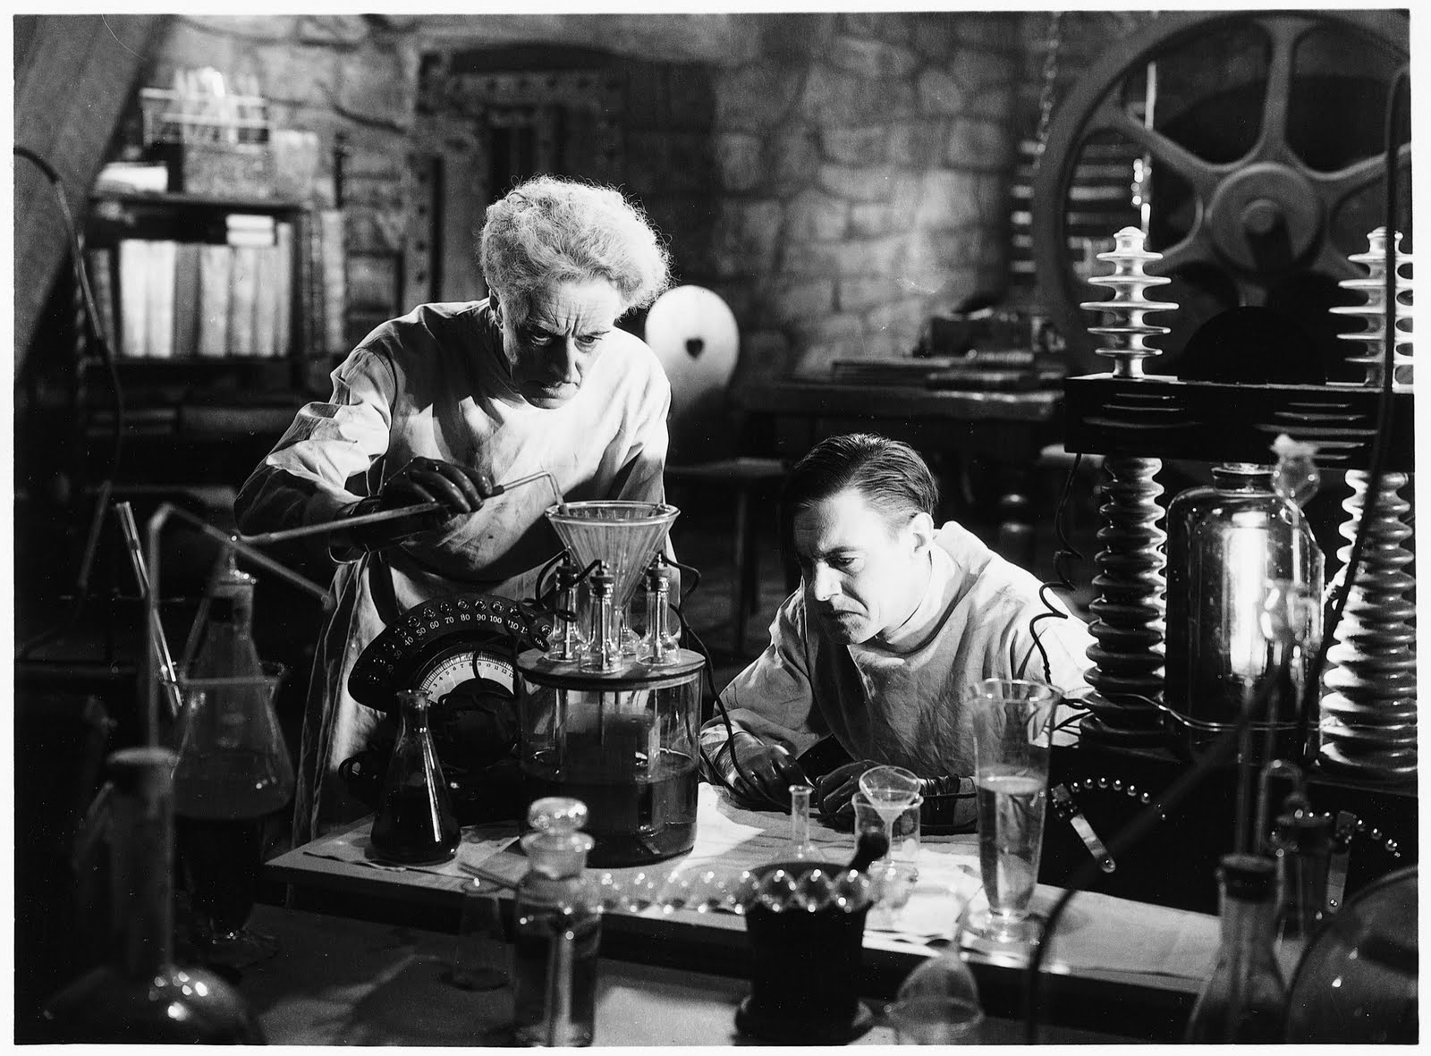
Introduction to Research
Making the choice depends on:
1. The research problem

Slide 19
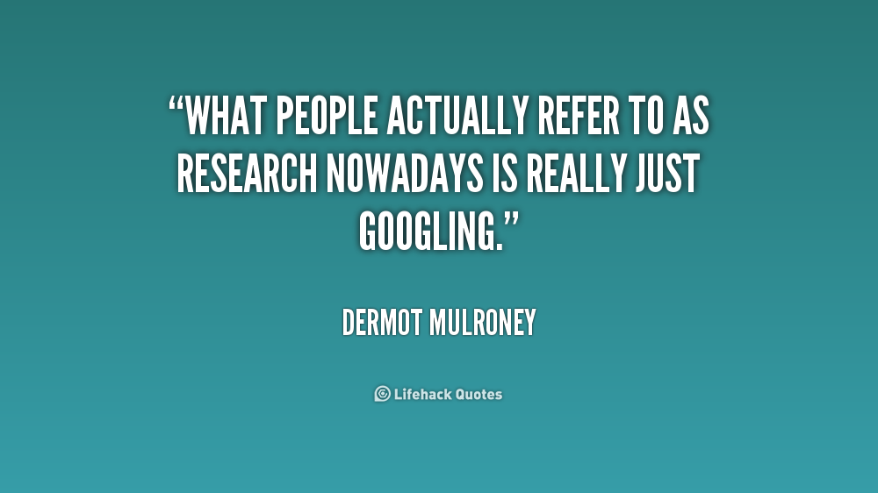
Introduction to Research
2. What a review literature establishes as the importance of the problem.

Slide 20
Introduction to Research
Research Process
Research
Problem
Literature
Review
Research Questions
Quantitative
Research
Qualitative
Research
Research
Designs
Flow of the research process
Cont on next slide.

Slide 21
Introduction to Research
Research
Designs
Flow of the research process
Quantitative Design
- Experimental
- Correlational
- Survey
- Design Science
Combined Design
-Mixed Methods
-Action Research
Qualitative Design
-Grouped Theory
-Ethnography
-Narrative
Sampling
Instruments
Protocols
Data Analysis
Interpretation
Discussion, Conclusions, Limitations, Future Research

Slide 22
Introduction to Research
Research
Designs
Flow of the research process
Design Science
Build Artifact
Instruments
Protocols
Data Analysis
Interpretation
Discussion, Conclusions, Limitations, Future Research

Slide 23
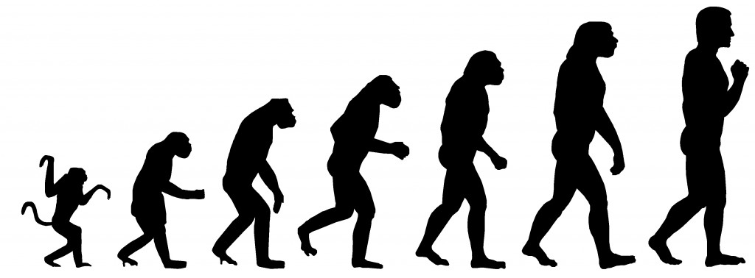
Introduction to Research
The reality is that most Research is not Revolutionary but Evolutionary

Slide 24
Introduction to Research
You need to read Chapter 1 of the text Creswell, J.W. (2012)“Educational Research”

